Slide 1
Testing Design techniques
Part 3

Slide 2
Equivalence Partitioning
Software Generalises
Groups of inputs will be processed in the same way
We choose a representative input from valid and invalid grouping
We do this intuitively already – this formalises the technique

Slide 3
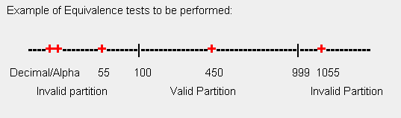
Equivalence Partitioning

Slide 4
Equivalence Partitioning
Applies for all validity rules: Ranges, Counts, sets
Derived variables can have invalid partitions also – high monetary amounts may trigger error messages
Needs to be precise – clarify the specifications
Eg. ‘…must be between 25 - 50’ does between include the values ? Also in monetary or time calculations – round up/down etc

Slide 5
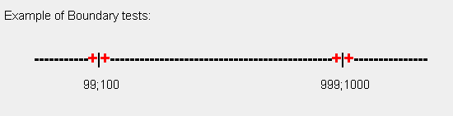
Boundary Value Analysis

Slide 6
Boundary Value Analysis
Tests values on/just above/just below the partition to find faults
If you cover all boundary values you automatically get EP coverage
Boundary tests should be performed for output partitions also … derived variables for example

Slide 7
Decision Tables
Contraints on using Decision tables for deriving test cases are:
On conditional statements only
Order of conditions does not matter

Slide 8
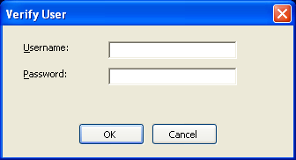
Decision Tables

Slide 9
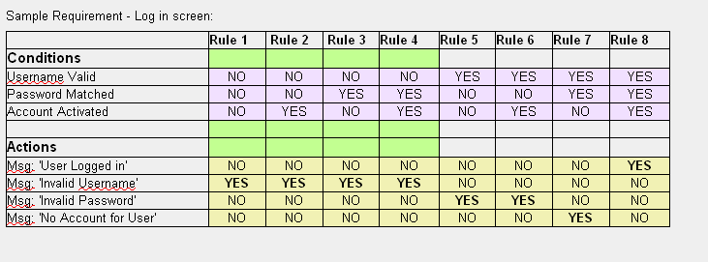
Decision Tables

Slide 10
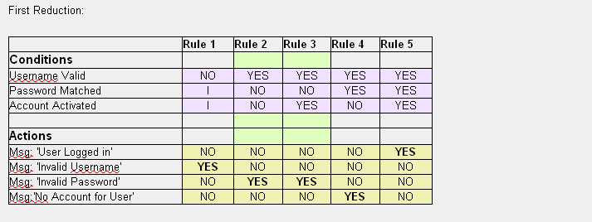
Decision Tables

Slide 11
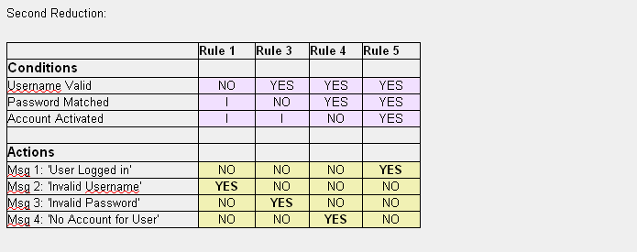
Decision Tables

Slide 12
Decision Tables
Test Case derived from Table:
- Test Case 1: Invalid Username - Expected Result: Message 2
- Test Case 2: Unmatched Password - Expected Result: Message 3
- Test Case 3: Valid Username and Password but account not activated -
Expected Result: Message 4
- Test Case 4: Valid Username and Password, Account activated –
Expected Result: Message 1

Slide 13
Decision Tables
Requirements can include many immaterial conditions
Requirements often have default or catch all rules
Once Boundary values are established

Slide 14
State Transition Testing
Examples of systems in states:
Electric Kettle
- Empty, full, cold, On, Off etc
Car
- Stationary, On, Off, neutral, forward,
Backwards, 1st gear, 2nd Gear etc

Slide 15
System States
A system state defines the current condition of a system at a given time
In a given state, a system will
- process only certain inputs
- permit the state to change to only certain
other states
State diagrams document the valid states that a system can take

Slide 16
State Transition testing
Examples of where state Transition modelling and testing might be appropriate:
Event driven programming [GUI]
Components with no user interface
In Blaise it is possible to adapt the State transition principles to model the myriad routes or paths through a questionnaire\block based on the changed state caused by a particular answer.

Slide 17
State Transition Testing
See Blaise example on Lotus Notes…..

Slide 18
Use Case Testing
Use cases involve actors who represent users and services within the system
Preconditions / Post-conditions
A mainstream scenario
Use cases are useful in Acceptance testing
Often referred to as scenarios

Slide 19
Path Testing
Program execution can follow distinct paths
Path testing is concerned with test cases that cause particular paths
Applicable to component testing
It requires intimate knowledge of the program structure or requirement specifications

Slide 20
Paths Testing
There are 2 techniques used in path testing
Statement coverage
- every statement executed at least once
Branch coverage
- every outcome of every decision executed at
least once

Slide 21
Statement Testing
Executable statements ‘do something’
Data definitions, elses, endifs, variable declarations are not statements
Statement coverage requires you to exercise each statement at least ONCE

Slide 22
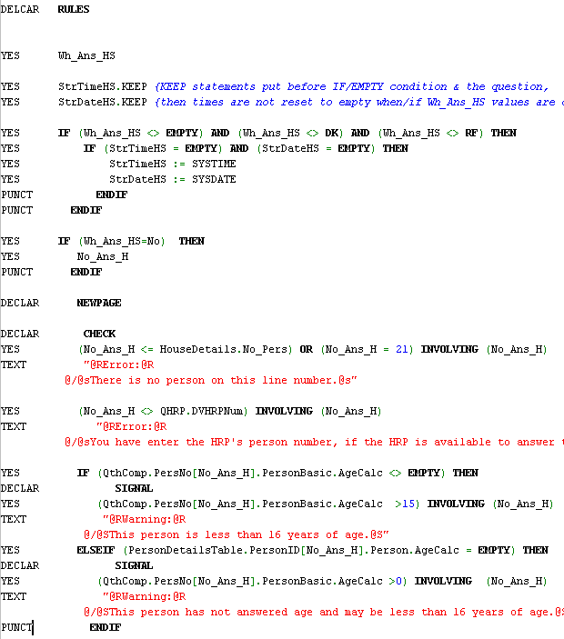
Statement Testing

Slide 23
Procedure for statement testing
Identify all executable statements
Trace execution from first statement
For each decision, choose the true outcome first, write down the variable values that make it true
Are all statements covered? If not, select variable values that reach the uncovered statement
Repeat 4 until all statements are covered by at least 1 test case
For all test cases, record the variable values required to force the execution path that you take

Slide 24
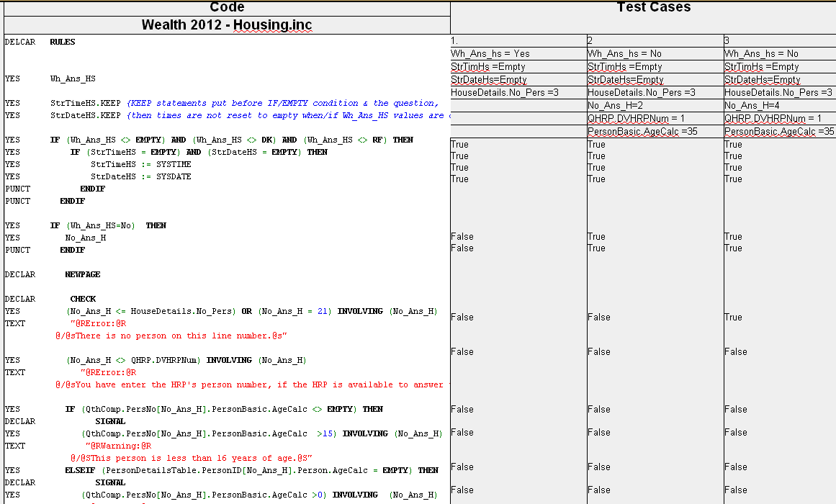
Statement testing

Slide 25
Test orgranisation
Programmers should do ad-hoc testing [test as they go]
First cut of component testing [module, manipula script etc ]performed by developer
Component and Integration perform by an independent developer on the Blaise Team
System test performed by team based on assignment
Acceptance tests performed by specifiers, interviewers etc

Slide 26
Finally….
Independence of mind is the issue
Good programmers can test their own code thoroughly if they adopt the right attitude
Buddy-checks/informal peer reviews can reduce the risk of bad assumptions, cognitive dissonance etc
Design of tests is the most important aspect

Slide 27
Thanks folks….

